Slide 1


Introduction to Go ProgrammingLanguage
Girish V

Slide 2

Presentation Overview
GO
What is Go programming language?
History of Go
Why go is born?
Designer team and users
Some outstanding features
Some basic syntax
Demo
KEY TOPICS

Slide 3


What is Go?
Go is a programming language designed by Google to help solve Google's problems.
Why GO?

Slide 4
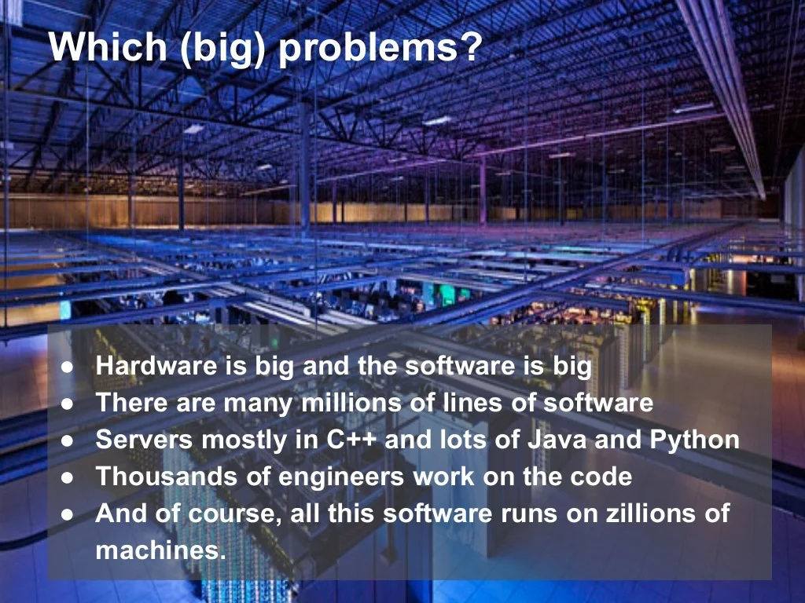

Slide 5
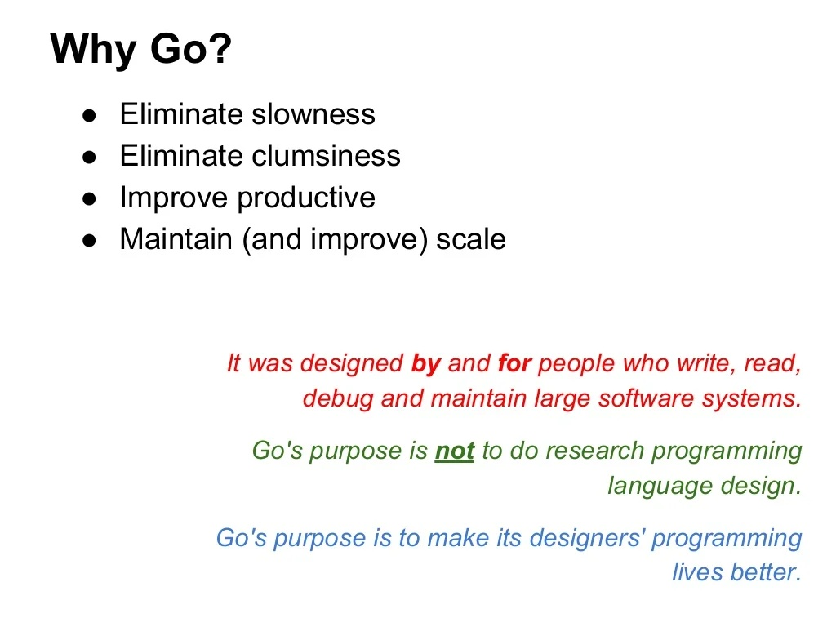
GO’s Goals ➔

Slide 6

What is GO programming language?
03
Go, also known as Golang,is a statically typed, compiled programming language designed at Google.
• open source
• concurrent
• garbage-collected
• efficient
• clean syntax
• Rich standard library
• Natively compiled
• scalable
• simple
• Concurrency and Networking
• fun
• boring (to some)
Though it's general purpose programming languages, but it's targeted towards System programming and server side programming (similar to C, C++, Rust, D)

Slide 7
LATE 2007: BORN
HISTORY OF
GOLANG
It was developed in 2007 by Robert Griesemer, Rob Pike, and Ken Thompson at Google
2008: Prototype to Reality
A lot of other people help to bring Go from prototype to reality
2009:OPEN SOURCE
It became open source in November 2009
2010: Adoption
Start to have adoption by other programmers
A young programming language
TODAY:MORE POPULAR
More and more developers use it
Today's version is 1.17.6

Slide 8

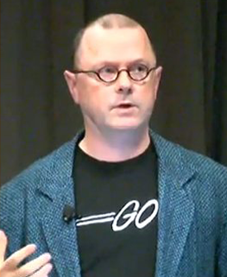
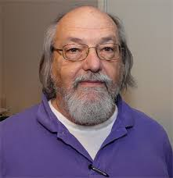
Design team
Fathers Of GOLANG
Robert Griesemer
Rob Pike
Ken Thompson
V8 JavaScript engine, Java HotSpot VM
UNIX, Plan 9, UTF-8
UNIX, Plan 9, B language, C, UTF-8

Slide 9
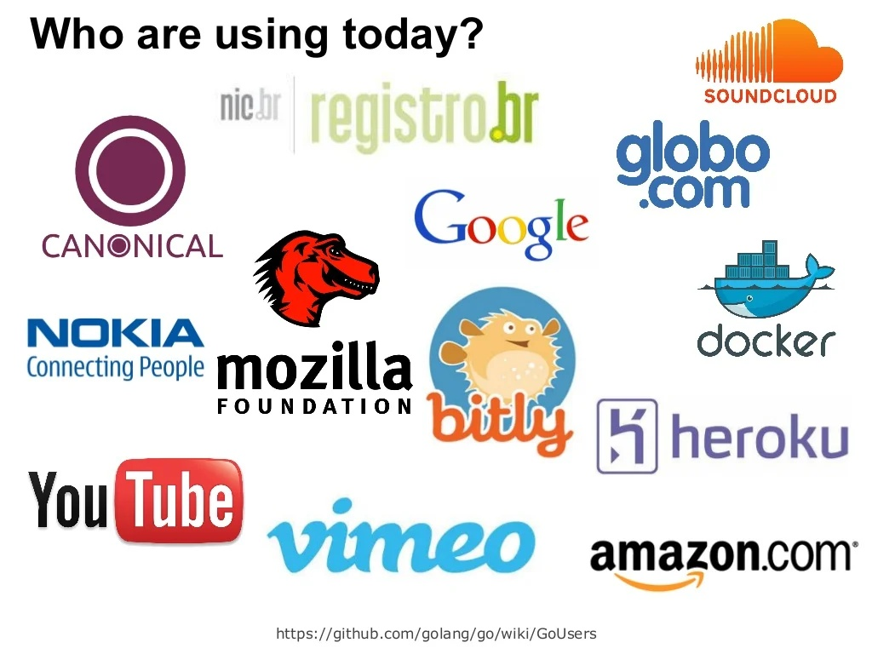




Slide 10
Advantages of GOLANG
1
GO grows faster than any other language.
2
GO compiled into many platforms.
3
GO uses multiple cores.
4
GO has Concurrency and Goroutines.
5
Easy to maintain.

Slide 11


Polularity and potential future
03
GO grows faster than any other language
In early 2017, according to Zdnet's statistics, GO surpassed its competitors, the popularity was 2.6%, climbing from the 54th position in 2016 to the 13th position. GO is the only language with such rapid growth.

Slide 12

Fast build and multiple flatforms
03
GO compiled into many platforms
The Go programming language is also compiled like Java, but unlike Java, it requires Java Virtual Machine to execute because Java compiles into Byte code, Go compiles to Machine code so it can run immediately with the operating system. It compiles without any further installation. That means, from my computer, I can compile programs running on Mac, Window, Linux.

Slide 13
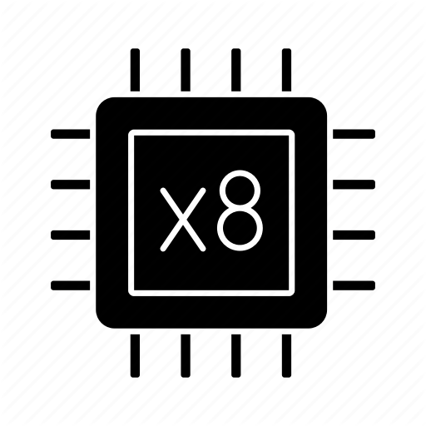
Multiple cores and easily to scale up
03
GO uses multiple cores
In the 1990s, one of the major changes in computer hardware was the addition of cores. Quad-core and octa-core CPUs significantly improve performance. However, programming languages created before that time only run on single-core computers, and they are built not intended to run on multi-core. But Go is different, the late born has created an advantage for it, computer hardware can expand the core, making Go a language that can be more easily scaled.

Slide 14

Frendly with HEAP and memory
03
GO has Concurrency and Goroutines
Concurrency is a key feature of the Go programming language to utilize CPU processing power. Usually other programming languages must depend on the allocation of operating system resources to run Concurrency, while Go can run Concurrency without operating system dependency. Concurrency is similar to thread, in Go, communication between goroutine is quite simple with channel, can transmit data between goroutine together by any kind of data.
Heap

Slide 15
More about Goroutine
JAVA
GOLANG
If a Java Thread is created, it uses approximately 1MB of Heap memory, if you create 1000 Thread like that, they will create a heap pressure that will cause the system to be turned off because of a memory shortage. On the other hand, it is difficult to communicate between two or more Thread.
But with GO is different, when using multi-core processors is feasible, Goroutines can completely replace Thread. Each goroutines only uses 2KB of memory from the heap, so you can create millions of goroutines at any time.

Slide 16
Advantages of Goroutine
Goroutines use memory flexibly for segmented stack, which will increase memory when needed.
Communicate between Goroutines using channel is extremely safe.
The boot time of Goroutines is faster than Thread.
Goroutines and OS threads do not exist 1: 1. Each Gorountine can run multiple threads at the same time, they can be combined into OS threads.
GO programming language

Slide 17
Goroutine | Thread
Goroutines are managed by the go runtime. | Operating system threads are managed by kernal.
Goroutine are not hardware dependent. | Threads are hardware dependent.
Goroutines have easy communication medium known as channel. | Thread does not have easy communication medium.
Due to the presence of channel one goroutine can communicate with other goroutine with low latency. | Due to lack of easy communication medium inter-threads communicate takes place with high latency.
Goroutine does not have ID because go does not have Thread Local Storage. | Threads have their own unique ID because they have Thread Local Storage.
Goroutines are cheaper than threads. | The cost of threads are higher than goroutine.
They have faster startup time than threads. | They have slow startup time than goroutines.
Goroutine has growable segmented stacks. | Threads does not have growable segmented stacks.

Slide 18

Maximize simplification
03
Easy to maintain
GO's syntax is extremely simple, without too complicated syntax like other languages. Go developers come from Google, a large-scale code-base place, and thousands of developers work together, so source code must be simple for any developer to understand and each block of code will minimize side effects. That makes the code easily to be maintained an changed.

Slide 19
Go ignores many features of OOP (Object-oriented programming)
Why we can say GO is Special?
No Class. Everything is bundled into packages. Go only have structs.
No inheritance support.
No constructor, annotation, generics or exceptions.
That makes Go different from the rest. Looking at the positive side, it makes the code more concise and easier to understand.
GO programming language

Slide 20
Things that are supported by GO
Some old things, some new things

Slide 21
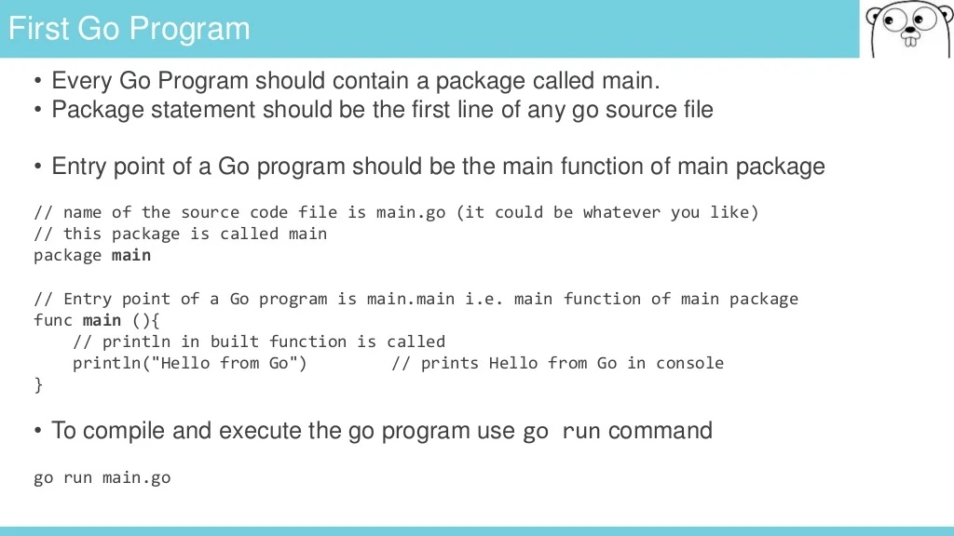

Slide 22
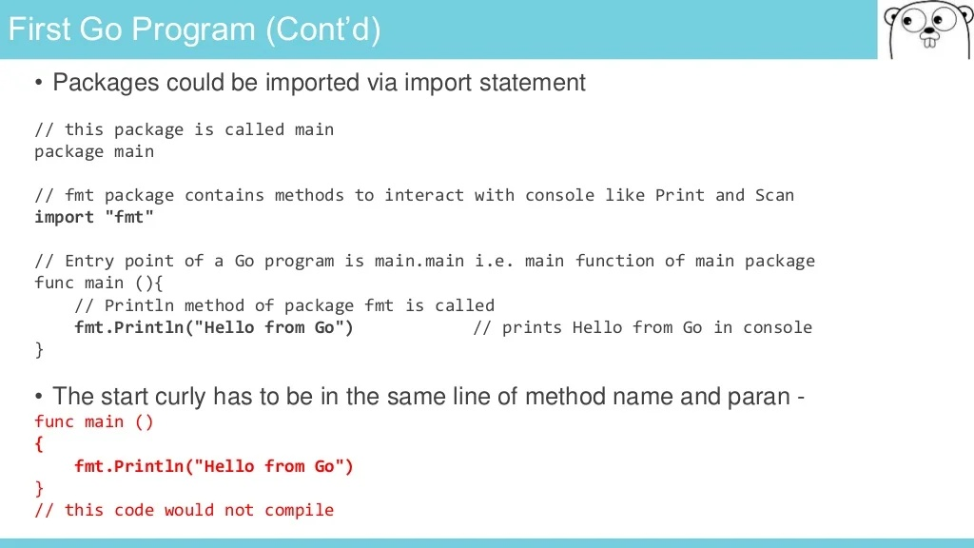

Slide 23
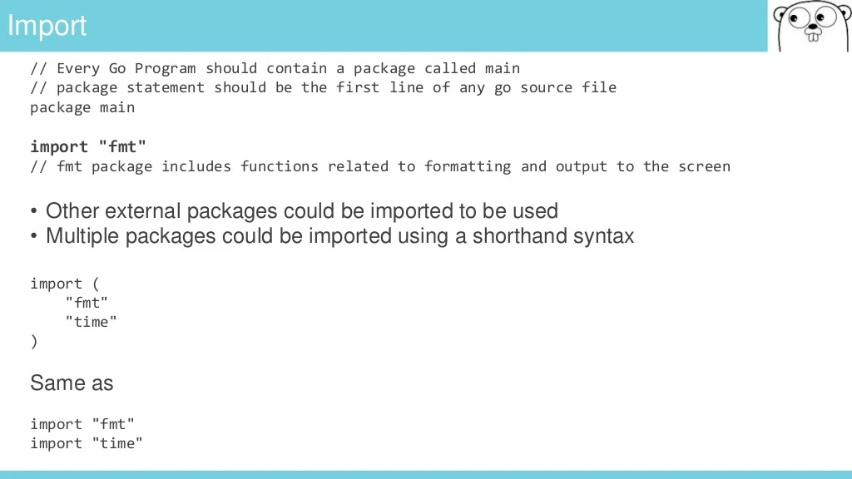

Slide 24
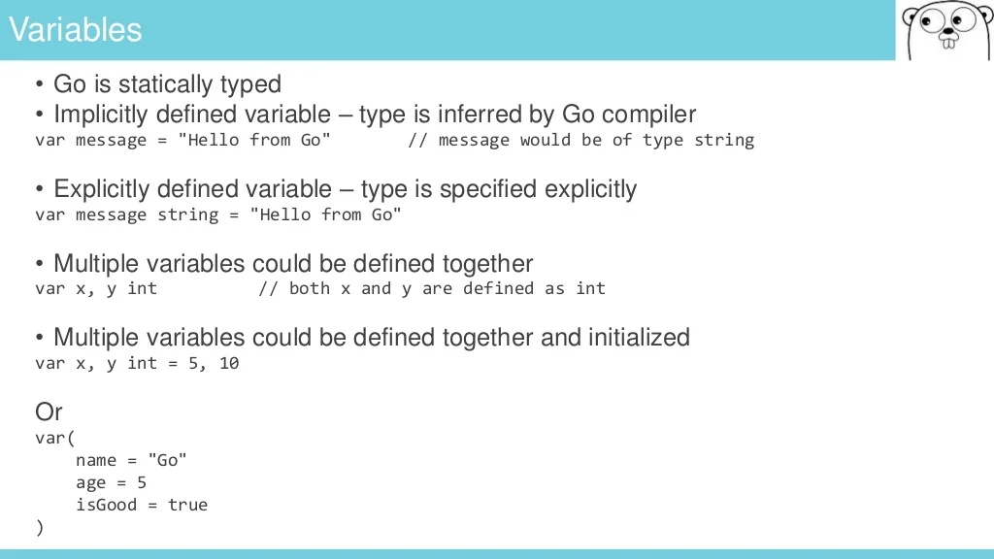

Slide 25
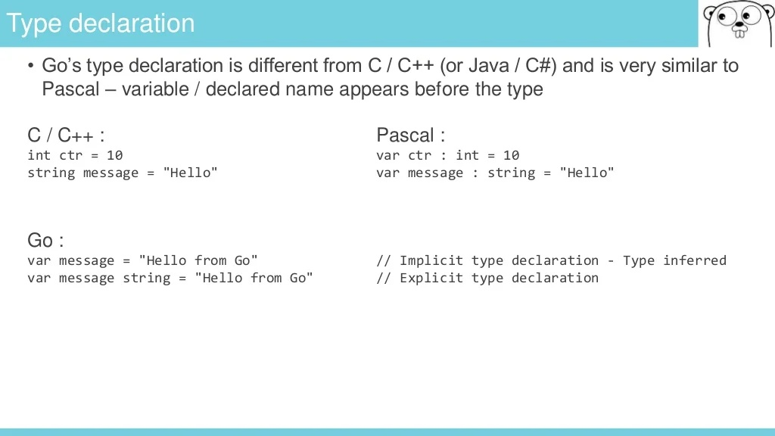

Slide 26
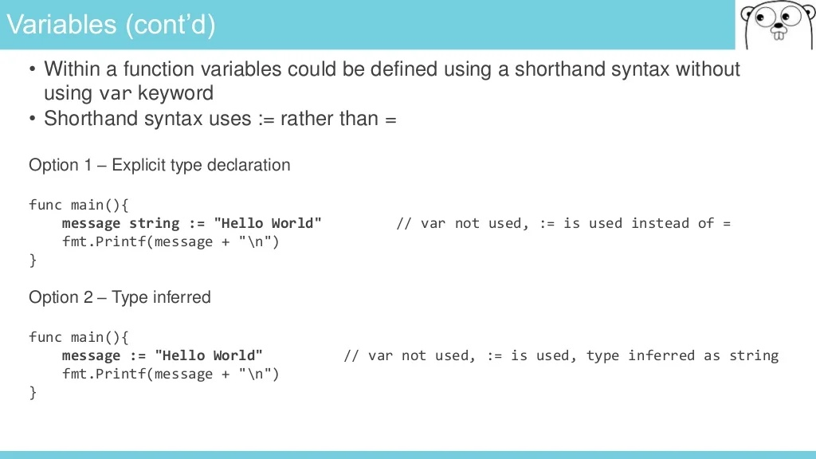

Slide 27
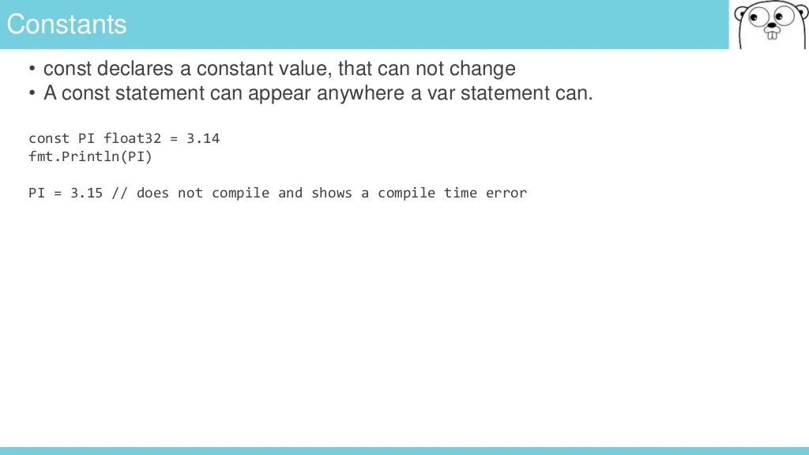

Slide 28
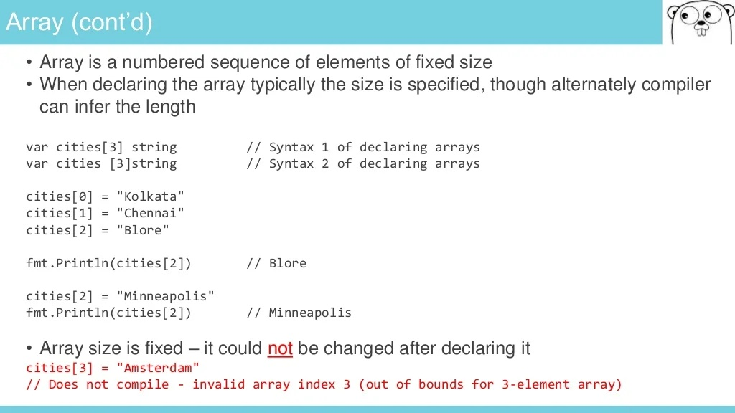

Slide 29
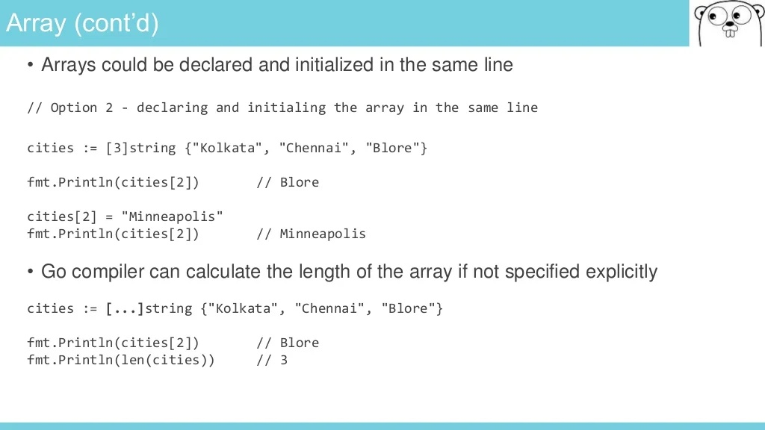

Slide 30
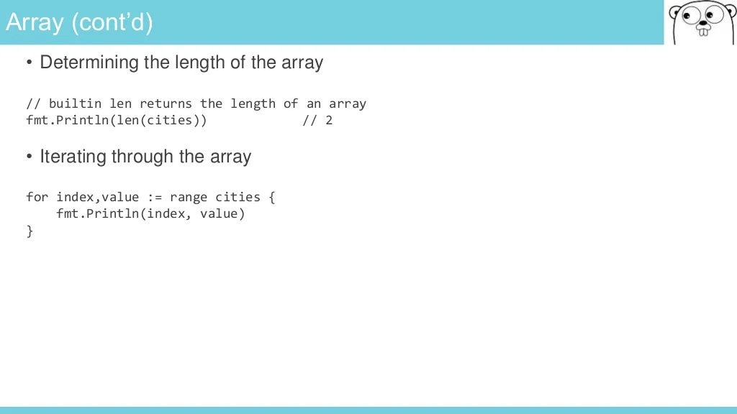

Slide 31
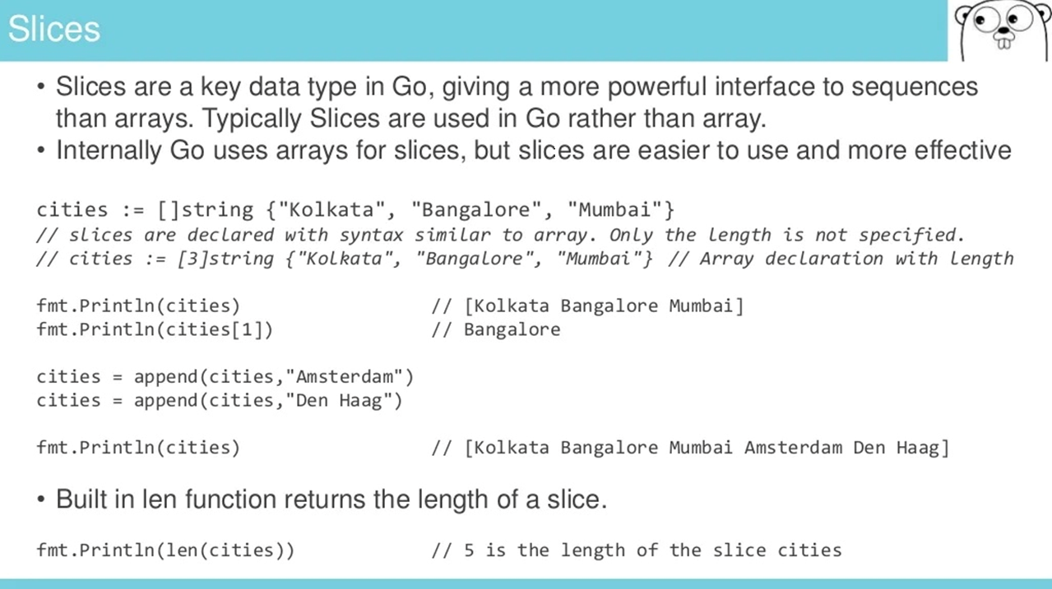

Slide 32
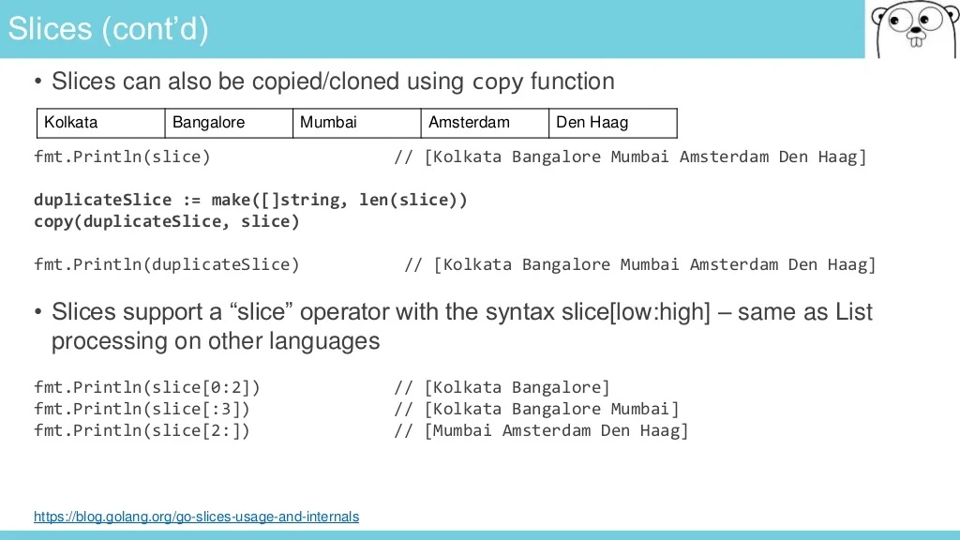

Slide 33
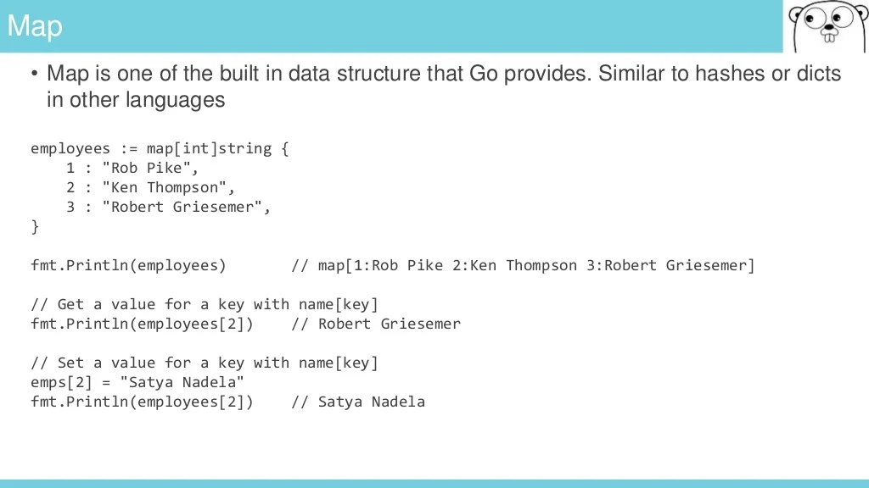

Slide 34
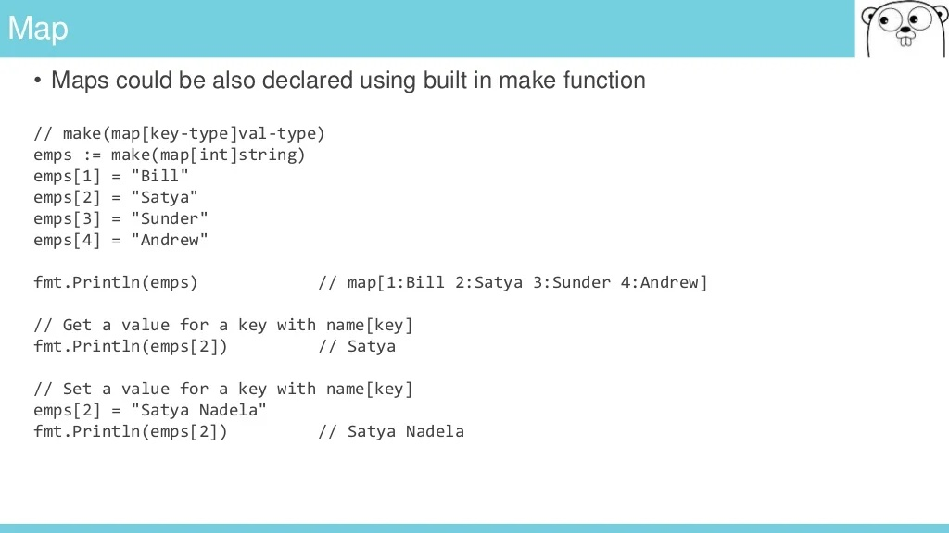

Slide 35
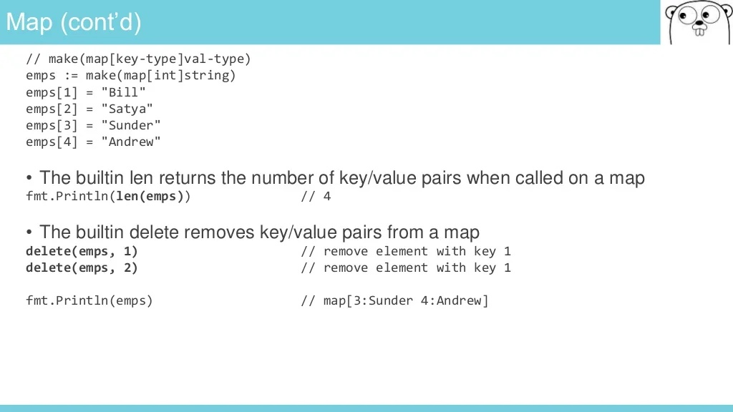

Slide 36
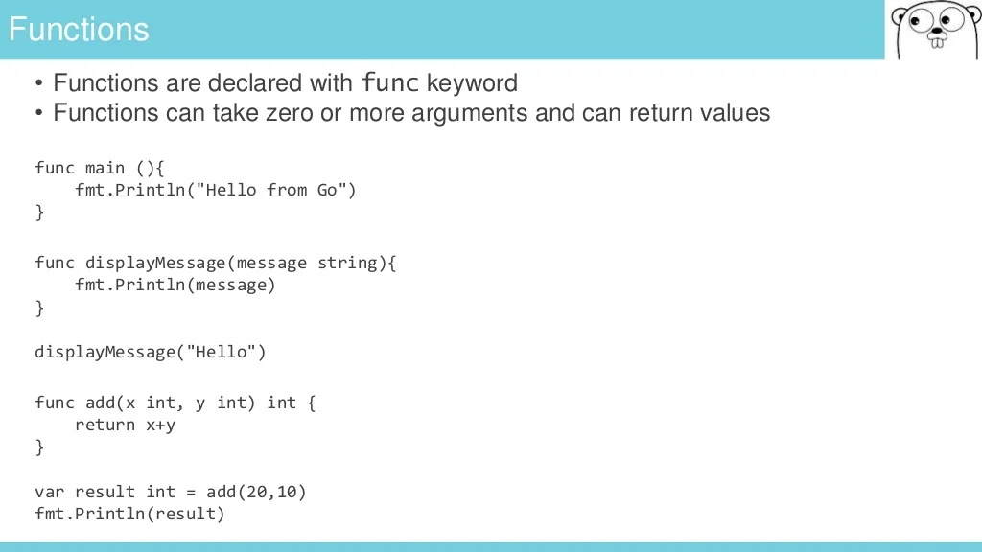

Slide 37
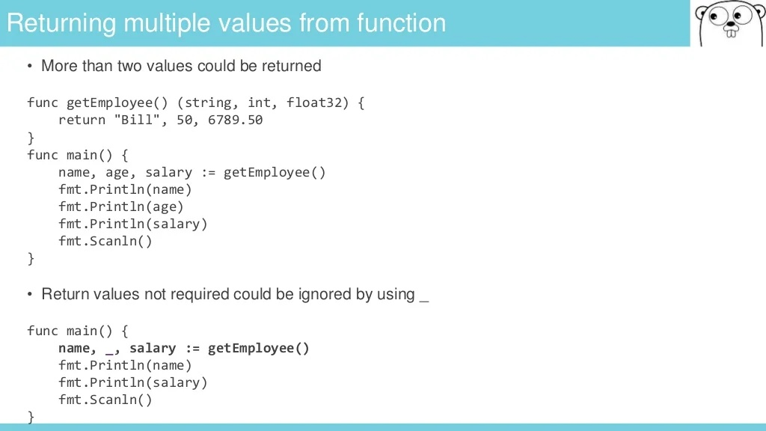

Slide 38
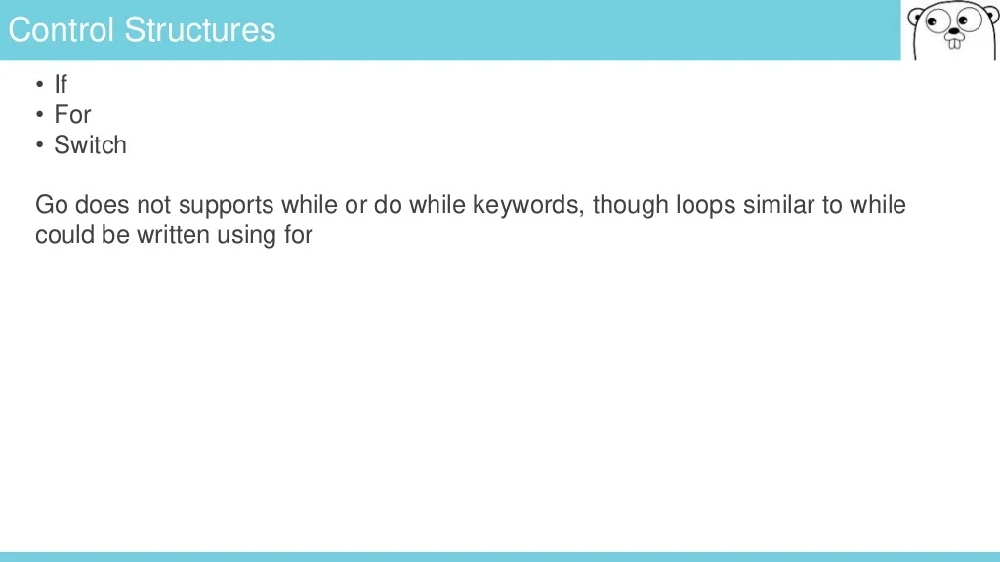

Slide 39
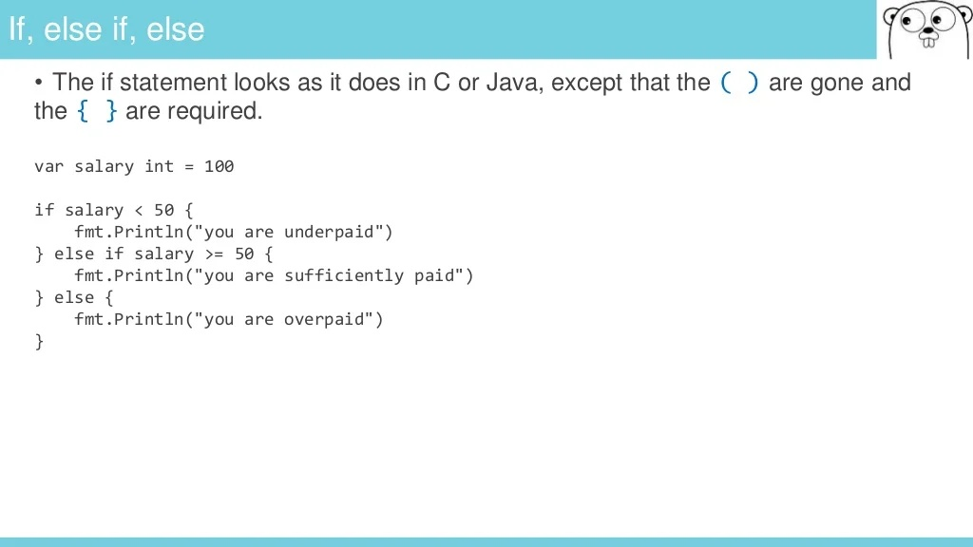

Slide 40
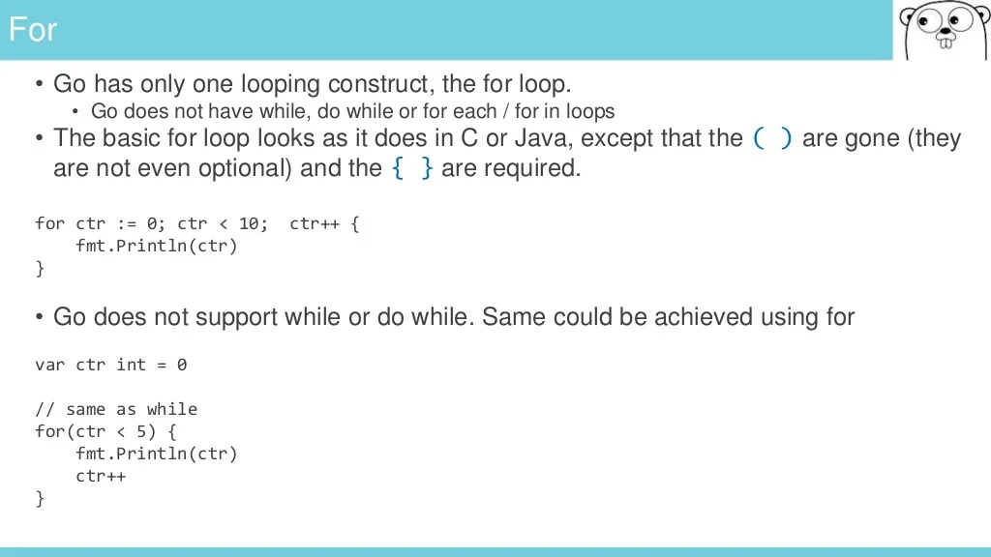

Slide 41
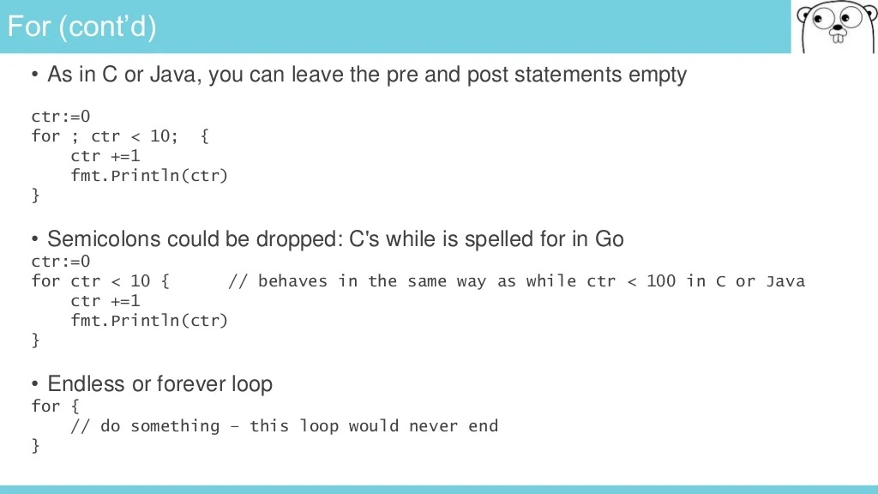

Slide 42

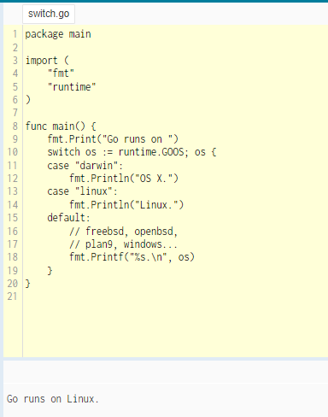
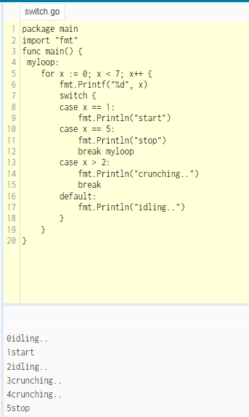
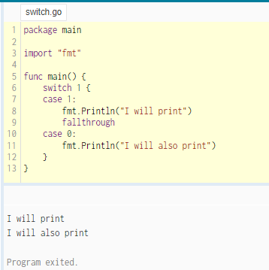
Switch
Go's switch is like the one in C, C++, Java, JavaScript, and PHP, except that Go only runs the selected case, not all the cases that follow.
In effect, the break statement that is needed at the end of each case
in those languages is provided automatically in Go

Slide 43
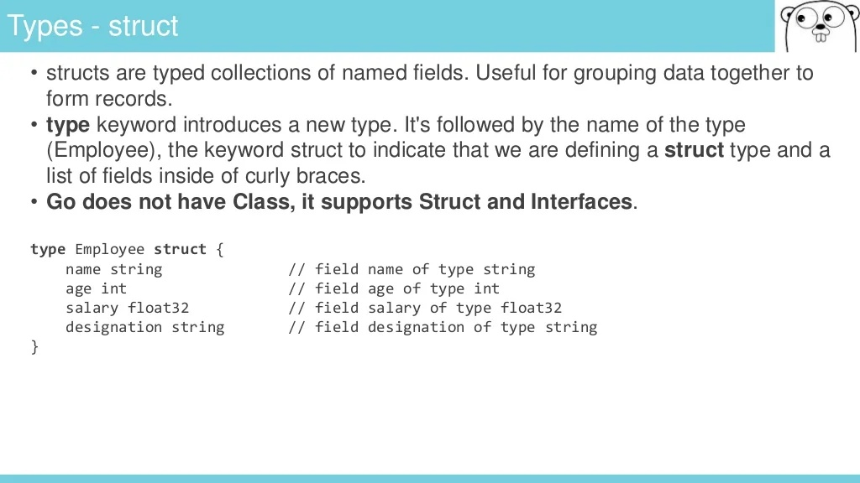

Slide 44
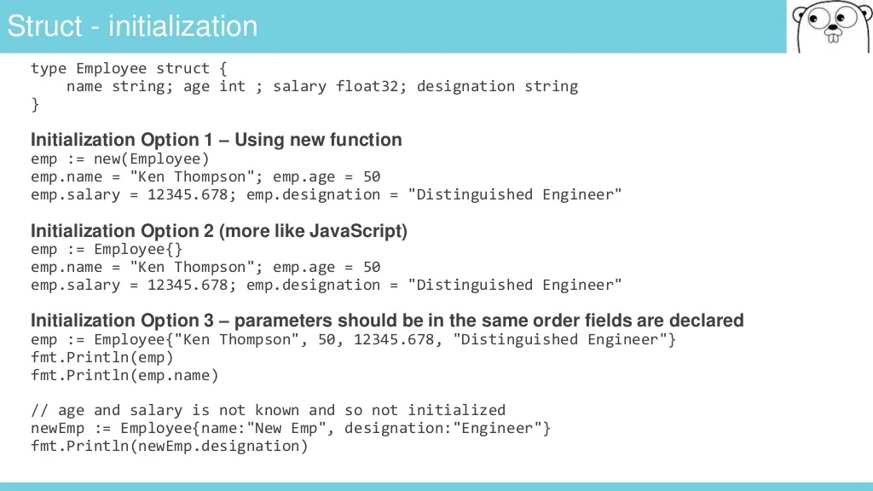

Slide 45
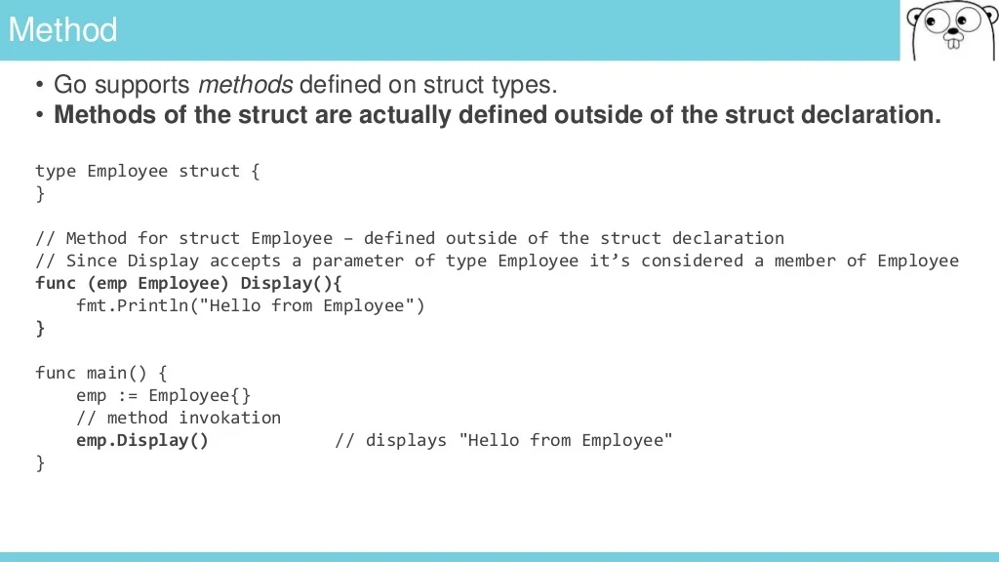

Slide 46
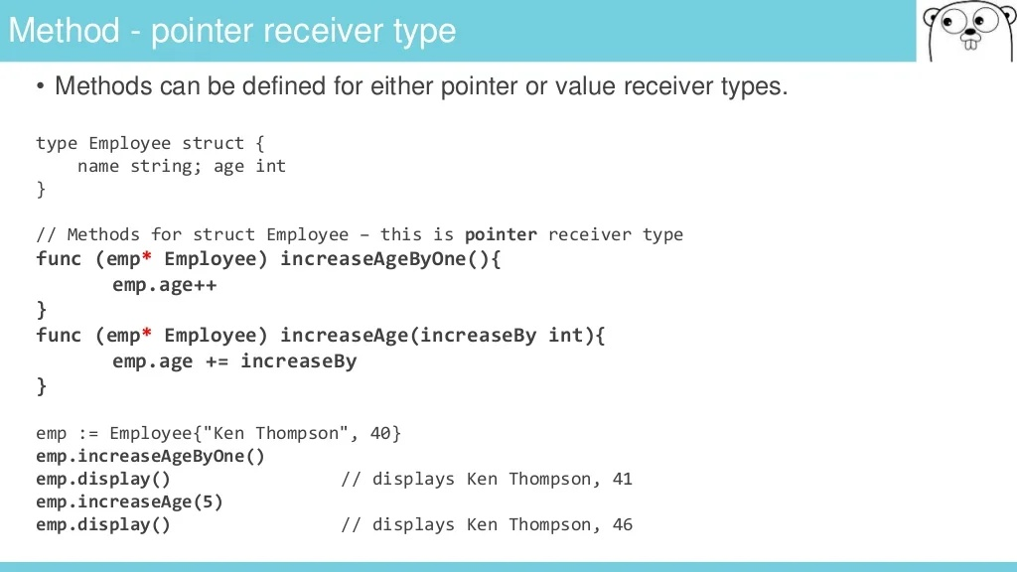

Slide 47
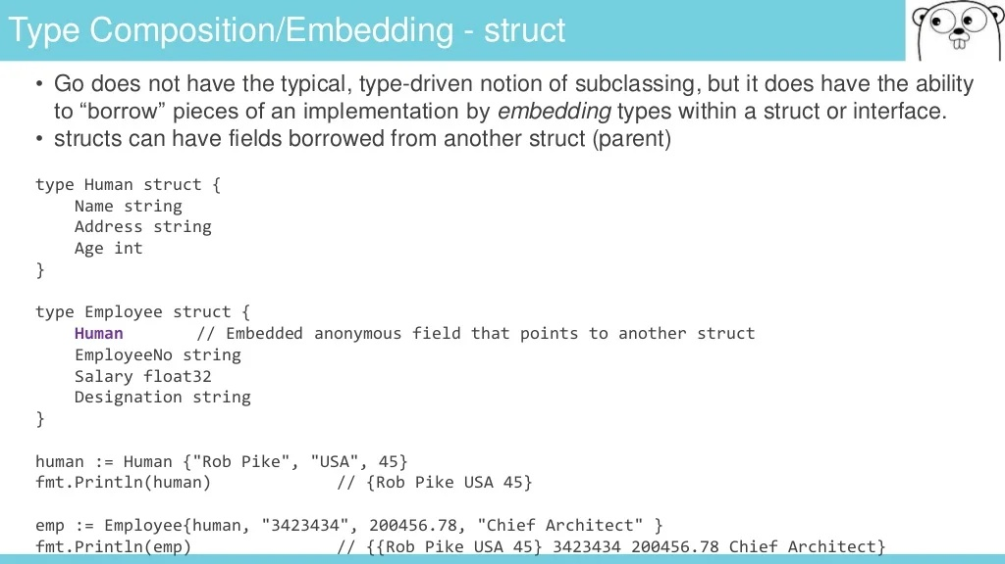

Slide 48
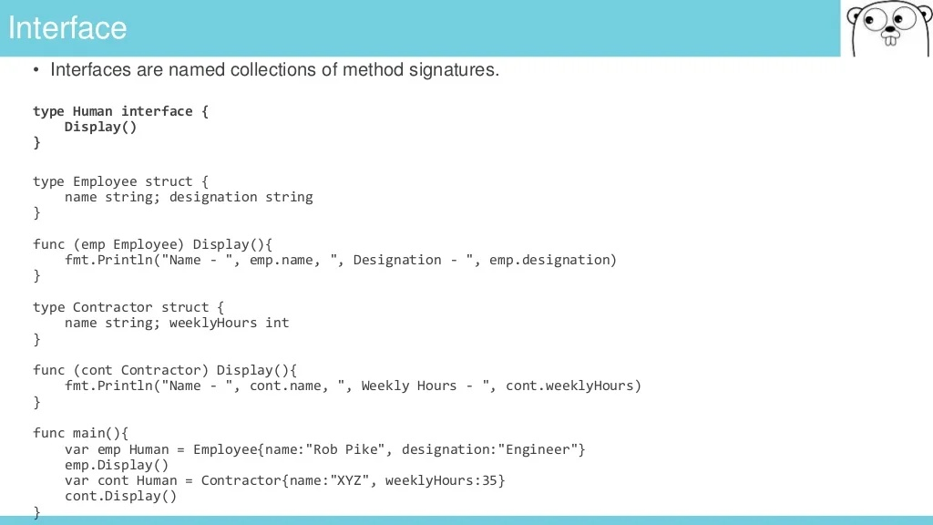

Slide 49
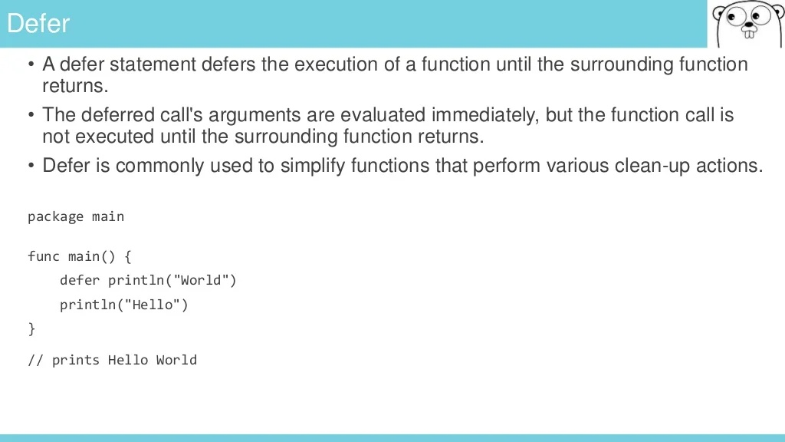
- The commands that are called via the defer keyword will be put on a stack, work following last-in-first-out mechanism

Slide 50
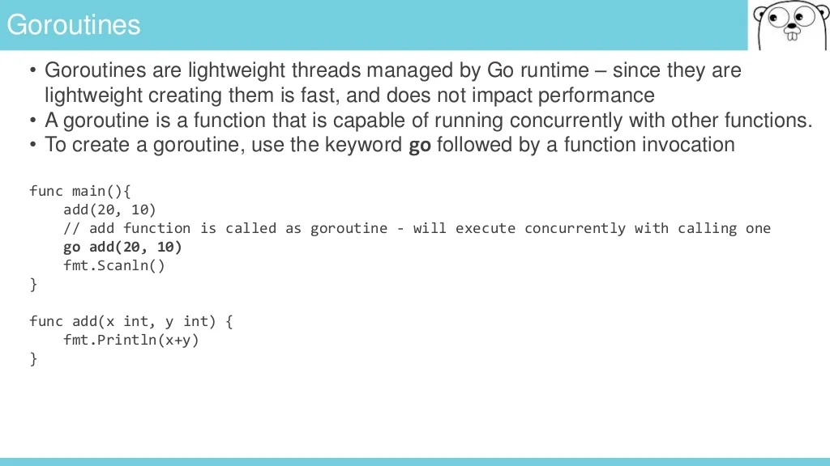
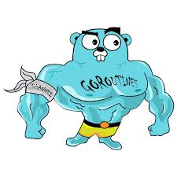

Slide 51
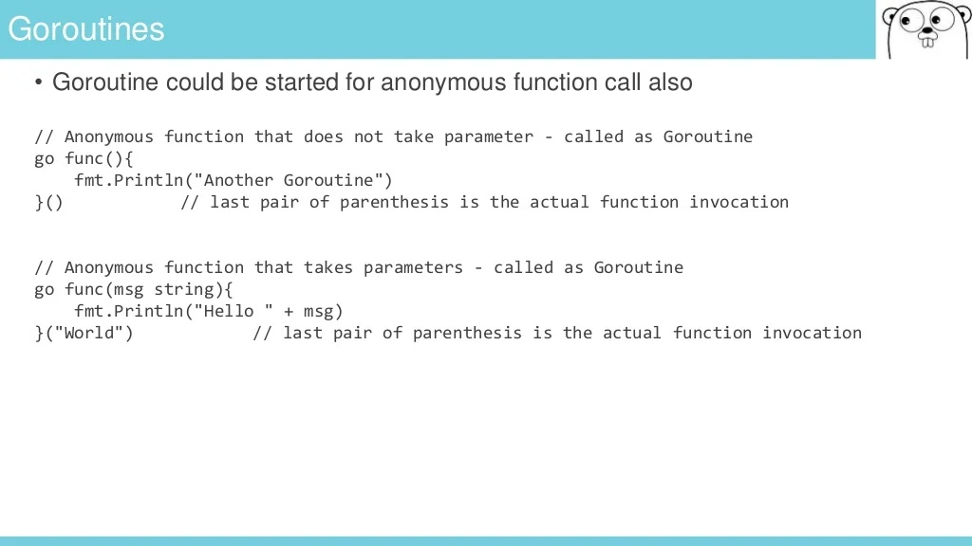

Slide 52
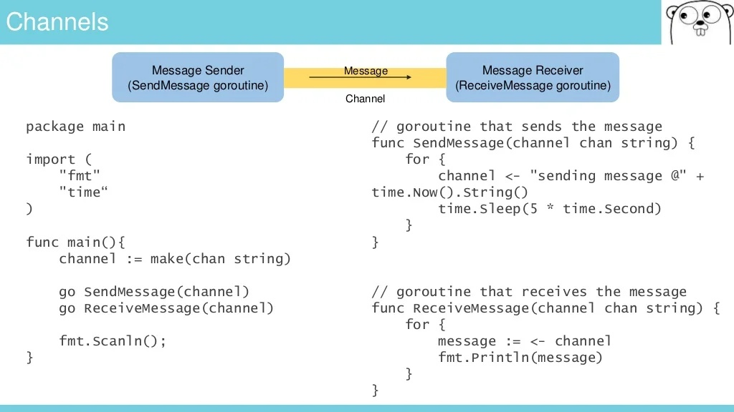

Slide 53
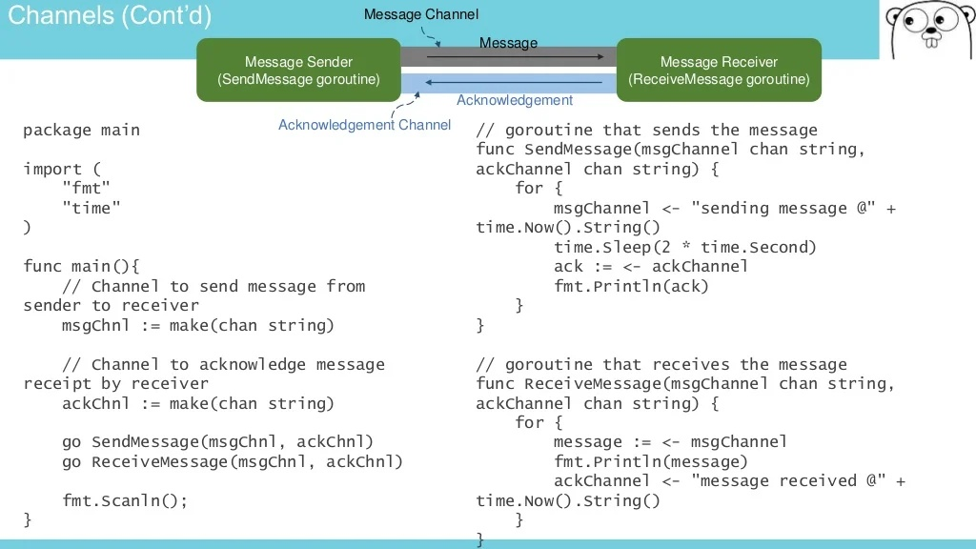

Slide 54
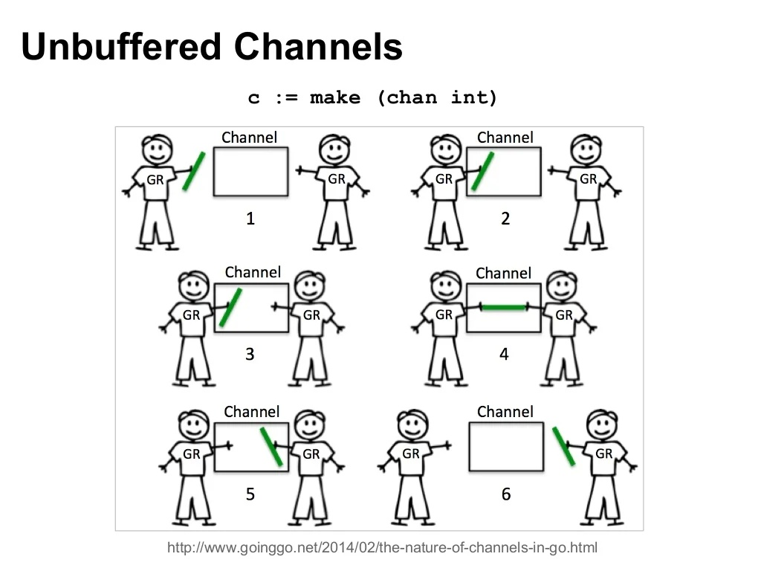

Slide 55
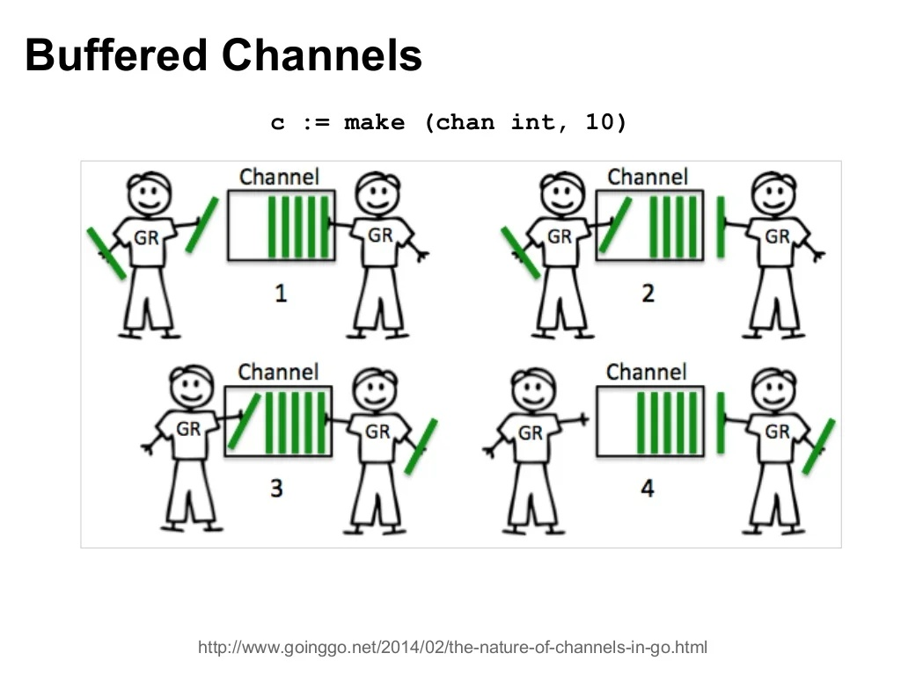

Slide 56
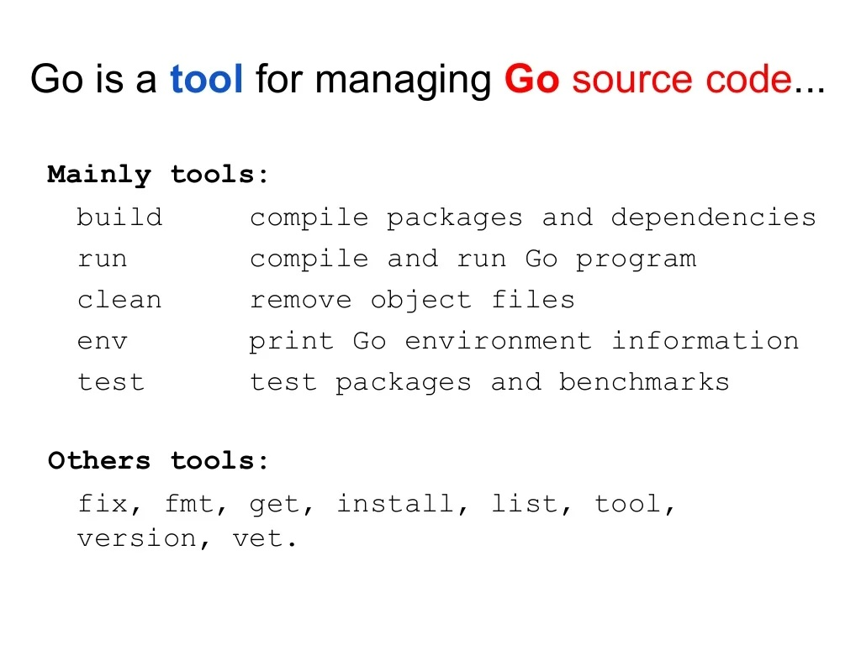
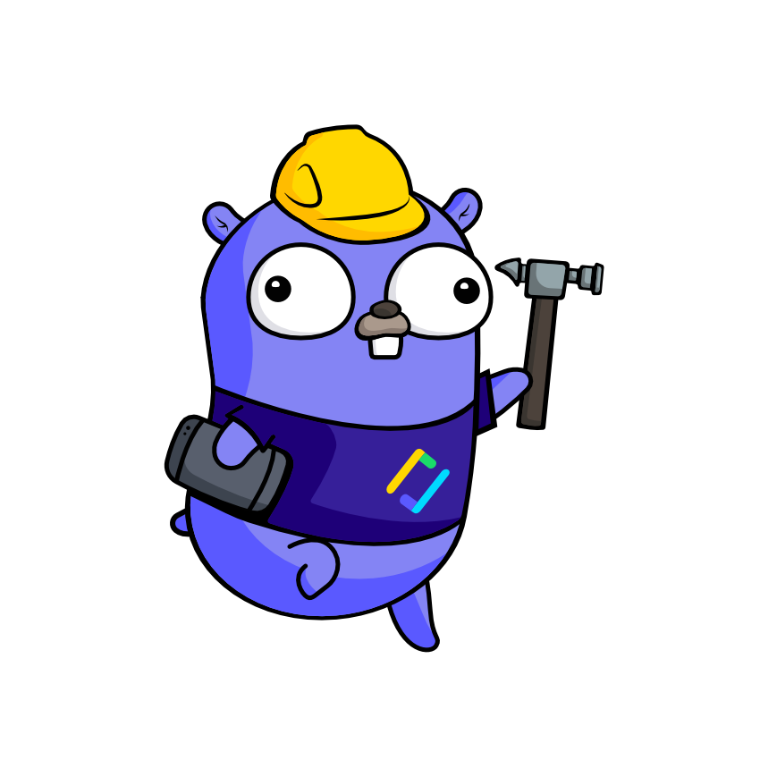
Go Tools

Slide 57
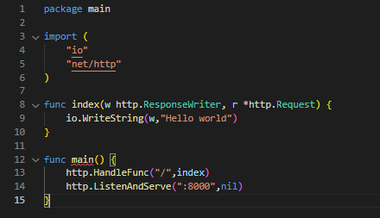
A Web Server
It is just simple to build a web server with 15 lines or less !! Could you believe that ?

Slide 58


Slide 59


Slide 60

Thank
You

